Slide 1



PWC Call Centre Analysis
View in Power BI
Last data refresh:
21/05/2023 14:30:03 UTC
Downloaded at:
21/05/2023 14:32:23 UTC

Slide 2
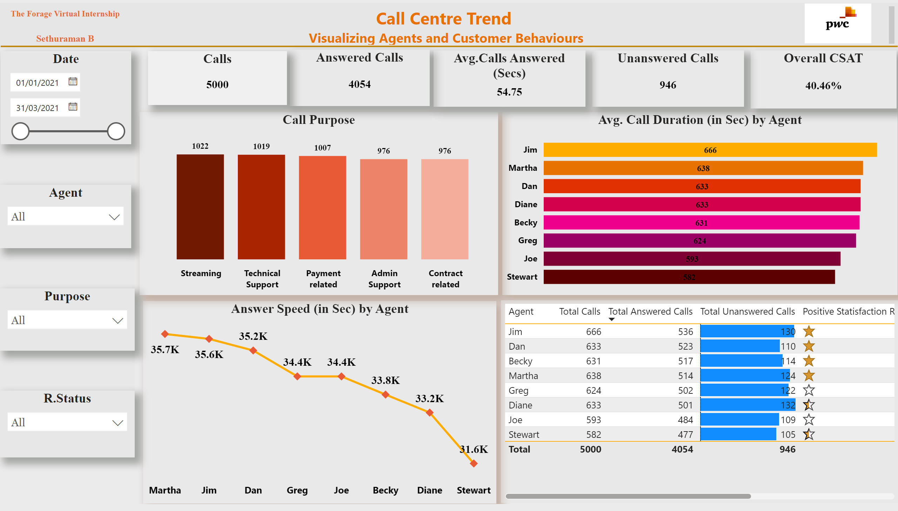
Page 1
Notes:
Agent
No alt text provided
Date
No alt text provided
Purpose
No alt text provided
R.Status
No alt text provided
textbox
No alt text provided
image
No alt text provided
textbox
No alt text provided
Call Purpose
No alt text provided
Avg. Call Duration (in Sec) by Agent
No alt text provided
Answer Speed (in Sec) by Agent
No alt text provided
tableEx
No alt text provided
Answered Calls
No alt text provided
Unanswered Calls
No alt text provided
Avg.Calls Answered (Secs)
No alt text provided
Overall CSAT
No alt text provided
Calls
No alt text provided
shape
No alt text provided

